Slide 1
Поездки и нужные слова
Trips and appropriate words

Slide 2
выбор слова
«место»
place space room seat

Slide 3
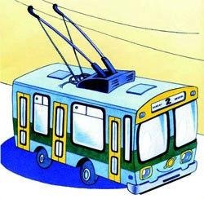
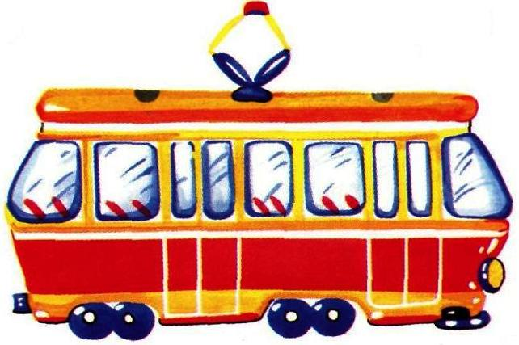
место в транспорте
seat

Slide 4
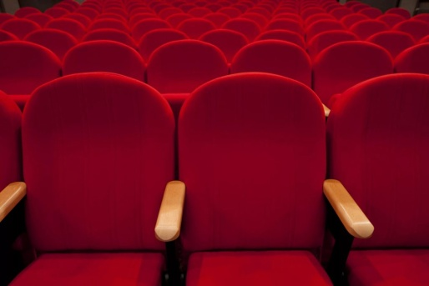
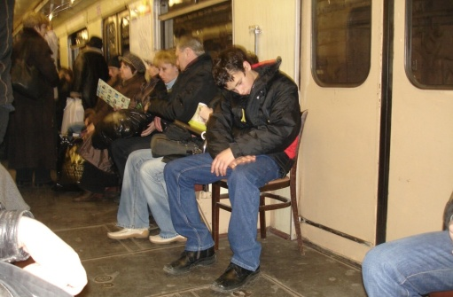
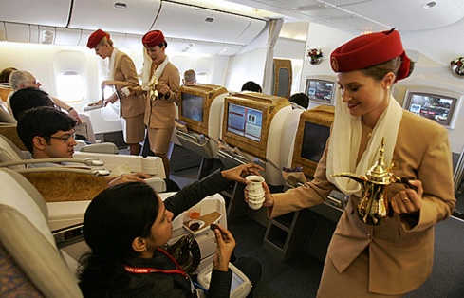
место
in the theatre
seat
in the cinema
in the underground train
in the plane

Slide 5
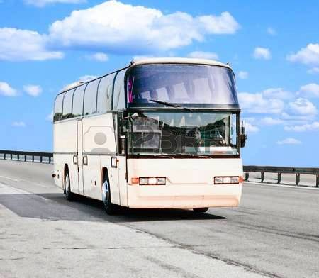
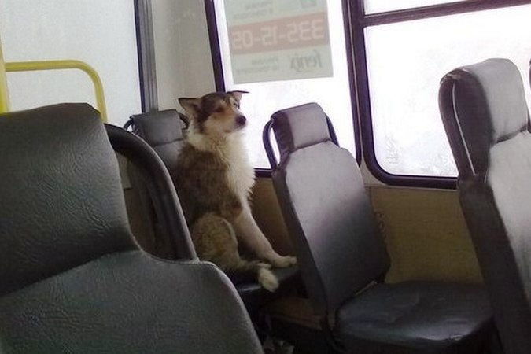
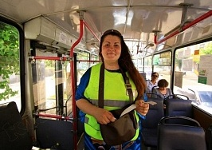
When should I buy a ticket? When I get on or get off?
seat
There are some seats.
Please, have a seat.
The conductor is going around the bus. She will come up to you.

Slide 6
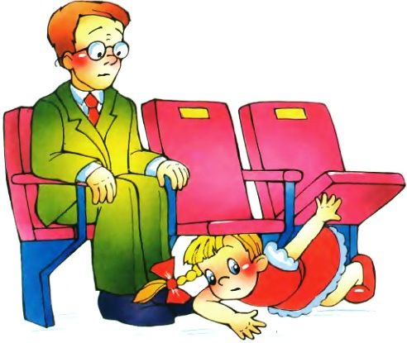
a seat - a space - room
My bag is rather big.
Is there any space for it?
There isn’t enough room for big things here.
I can hardly see the stage.
Could you take your seats, please.
There is some space under your seat.
a space = room

Slide 7
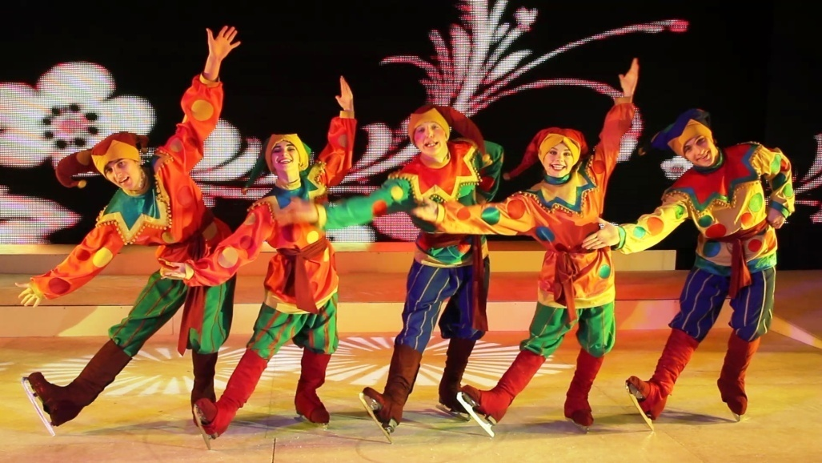
a place - a space - room
A theatre is a place for entertainment.

Slide 8
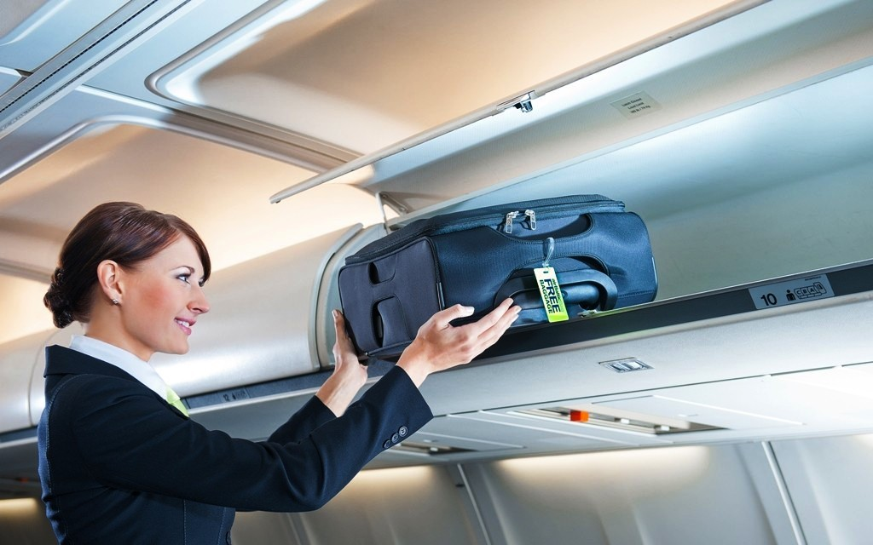
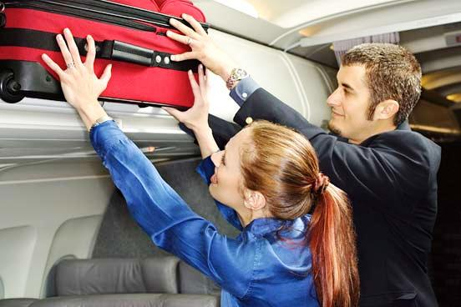
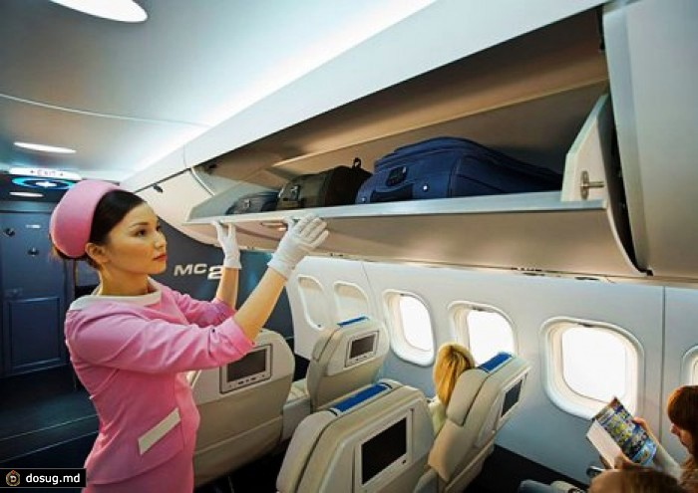
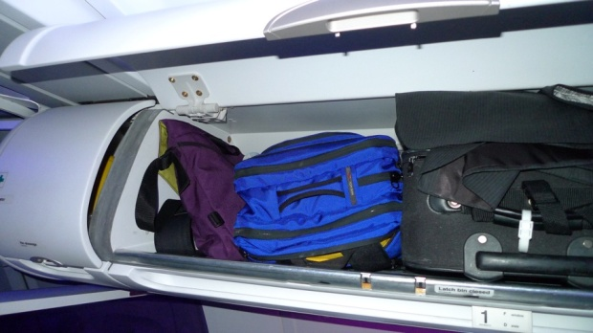
a place - a space - room
This is a place for hand luggage
There is not enough room
for the suit-case
Is there a space for my suit-case?
Yes, there’s room for your suit-case.
There is not any space.

Slide 9
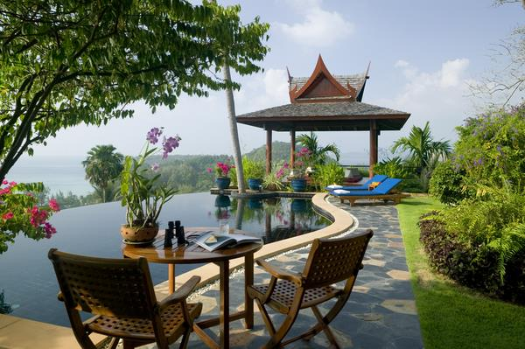
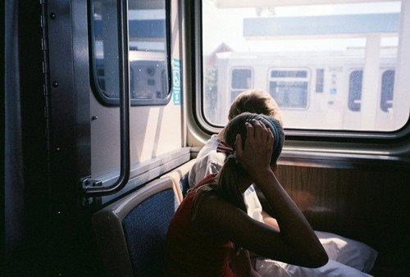
a place
a seat
A park is a nice place for walking.
We have found our seats.
The seats are good enough.
room = a space
There’s room for your suit-case.
There is not any space.

Slide 10
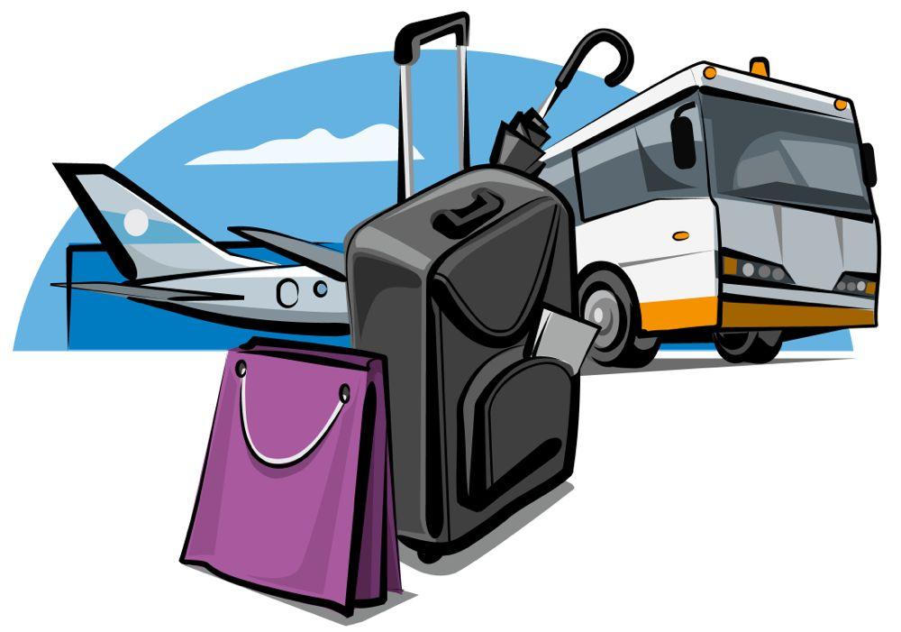
Travel all over the world
Have a nice time!

